Slide 1
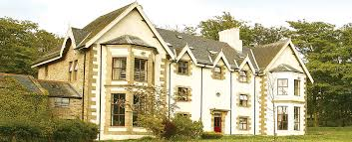
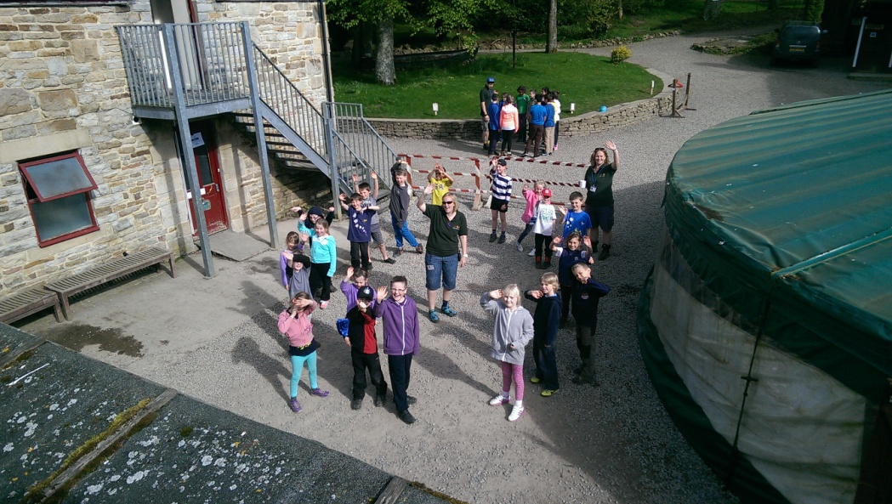
Year 4 Robin wood
Presentation 2014
By Year 4

Slide 2
Learning Objectives for Robin Wood
Independence
Confidence
Perseverance
Team Work
Problem Solving

Slide 3
Before we went
Before we go we all meet in the hall.
We went to the bus and the parents waved us away.
We left on a Wednesday morning and came home on Friday night
We were mega excited to go!!

Slide 4
The cool activities
caving
Zip wire
Piranha Pool
Dragon quest
canoeing
Moorland
Challenge
Crate challenge
Giant swing
Team challenge
archery
climbing
Stream walk
Trapeze
nightline

Slide 5
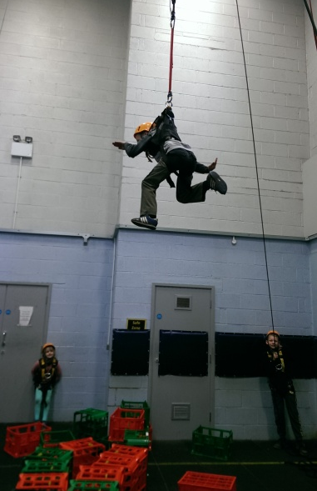
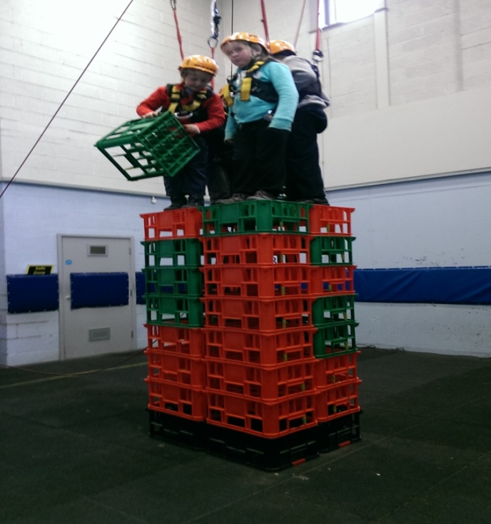
Crate Challenge
I thought the crate challenge was
AWSOME!!!
“I’m flying in the air”
The crate challenge was epic

Slide 6
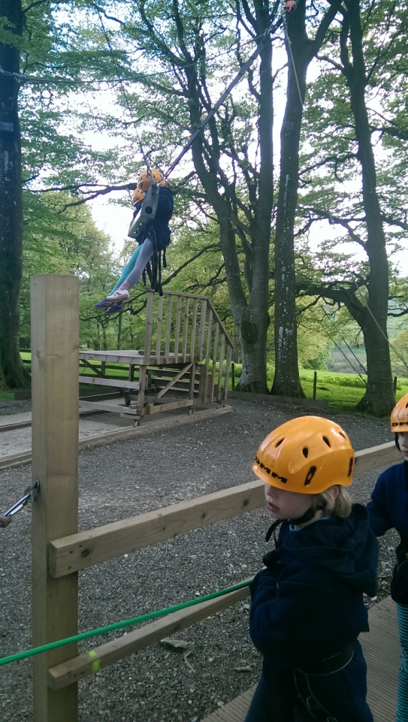
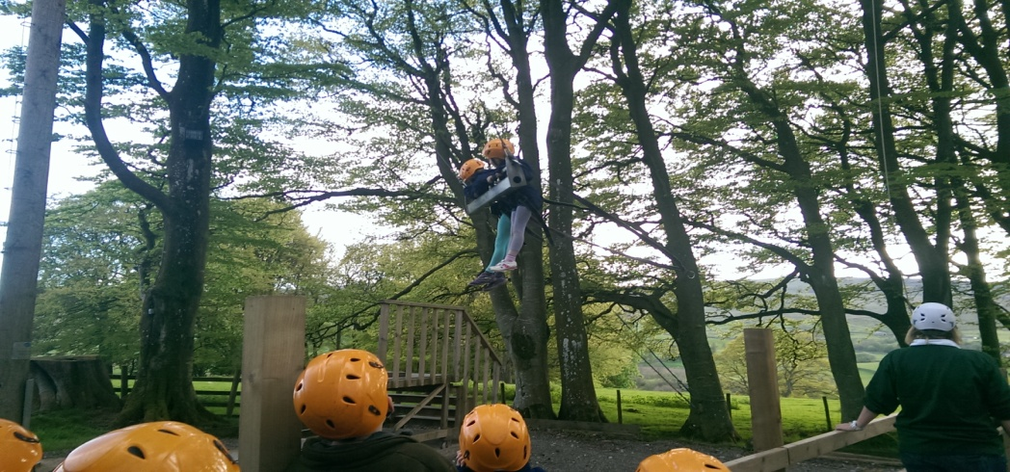
The rest had to pull on a rope to make the two people go up in the air!
Giant swing
This is cool
you had to shout 1 2 pull on pooh

Slide 7
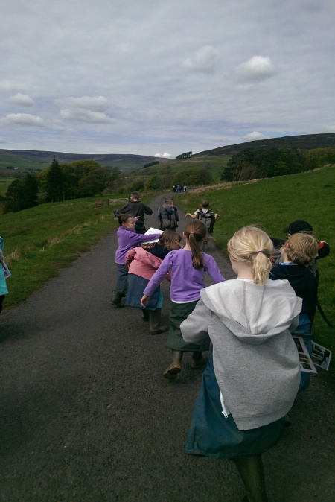
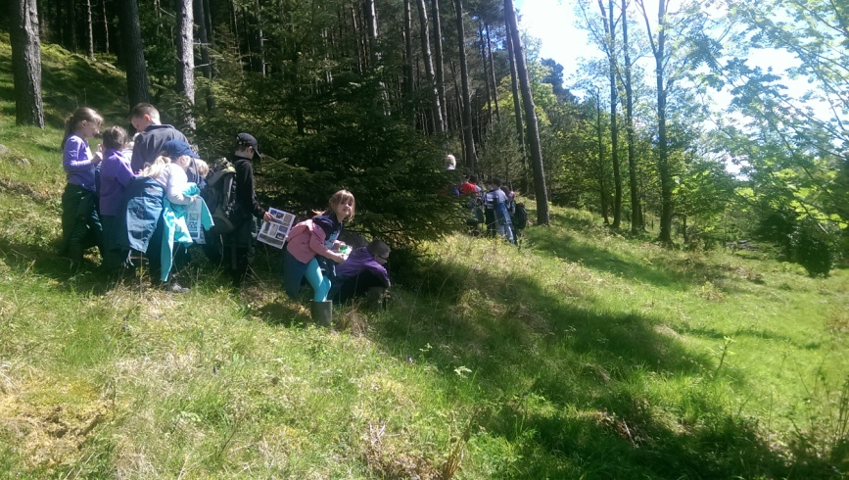
Moorland challenge
It's really cool!!
You get a picnic in the middle it is YUMMY
The other team sneaked up on us!!
SShhh!!!
Searching activities

Slide 8
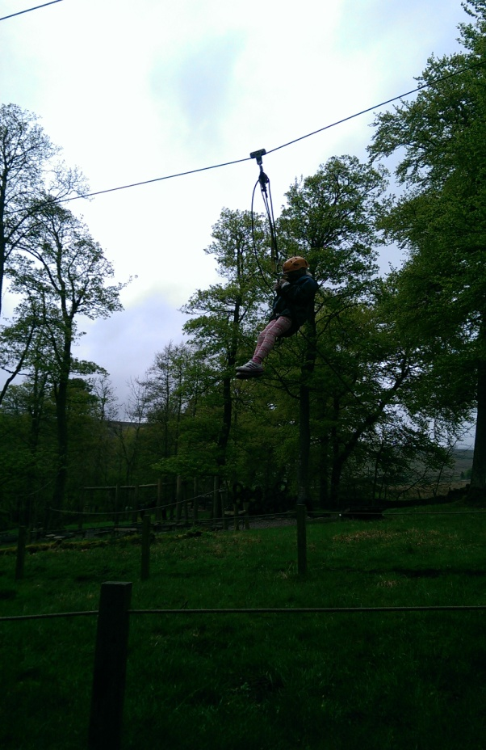
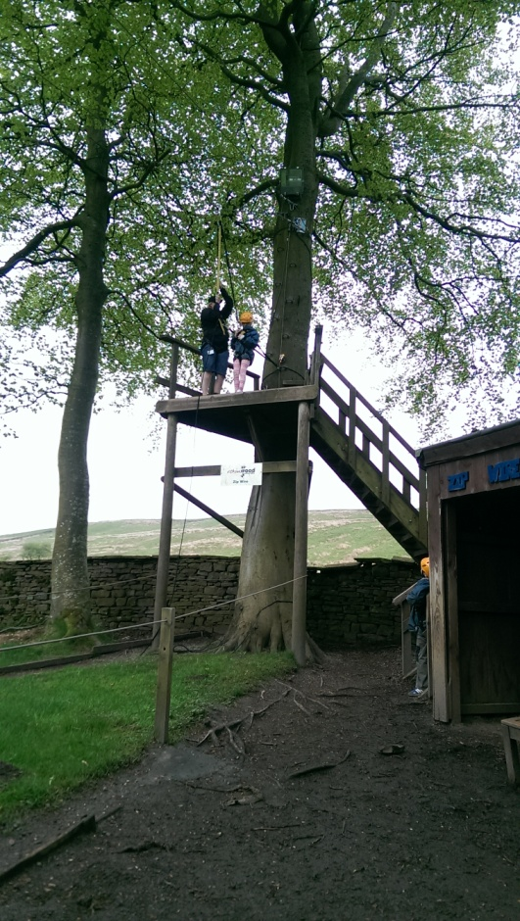
Zip
wire
1 2 3 CHUCK THEM OUT THE
TREE!!!
wheeeeee
YOU WENT TO THE
TOP AND YOU
FLEW DOWN!

Slide 9
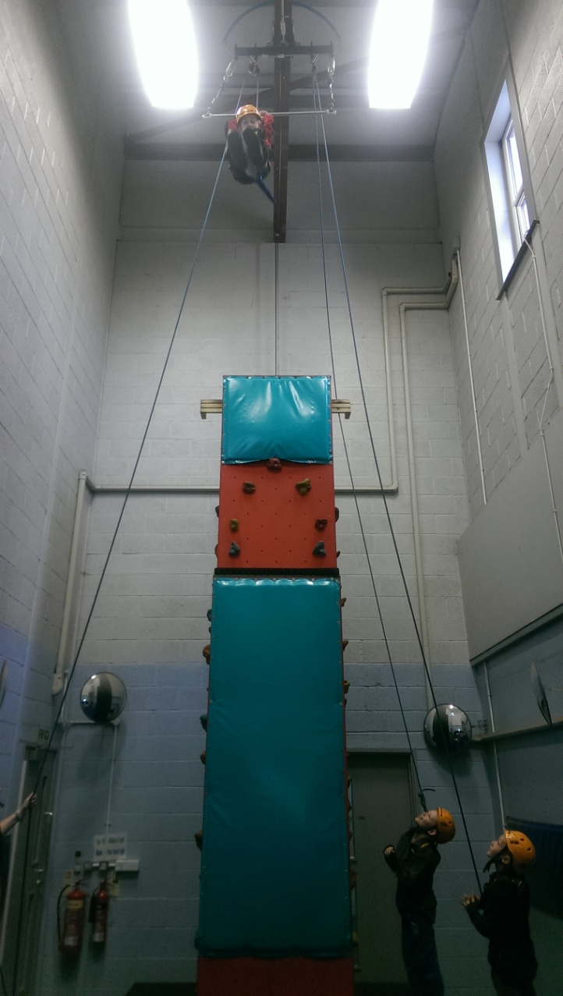
Trapeze
I’m flying in the air !!!!!!!!!!
The Trapeze was cool,
On the way down you did the BUM CHALLENGE I didn’t complete.
# FAIL!!!!!!!!!!!!!!!!!!!!!!
LOL!
It was awesome!

Slide 10
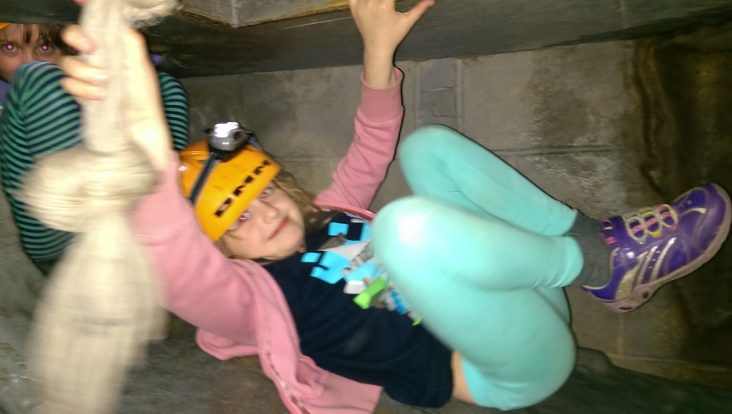
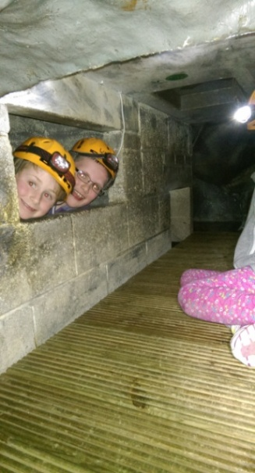
Caving!!!
epic
amazing
Oo i am monkey lol !!!!!!!!!
You will love it here
This is awesome
We played Zombies!!

Slide 11
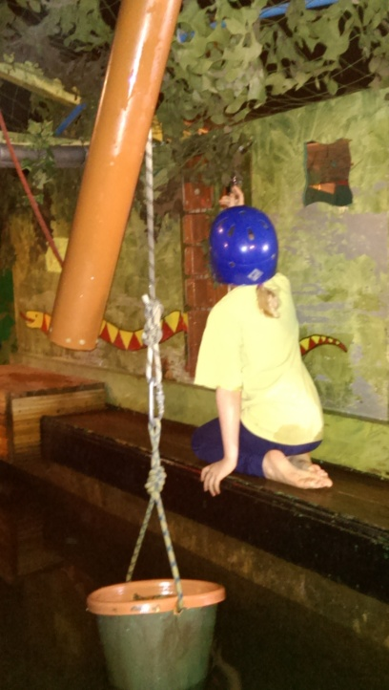
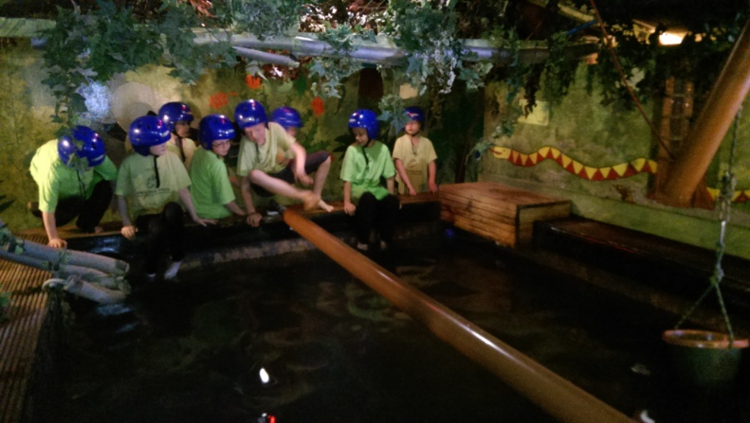
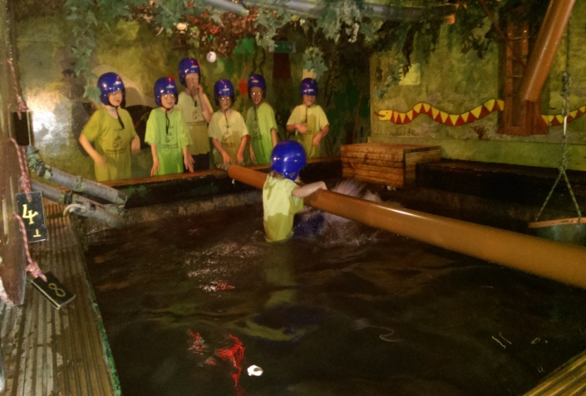
Piranha pool
I wonder hmmmmm
EPICNESS
Team Work!!
There is a tunnel if you do not want to go in
You will love it here

Slide 12
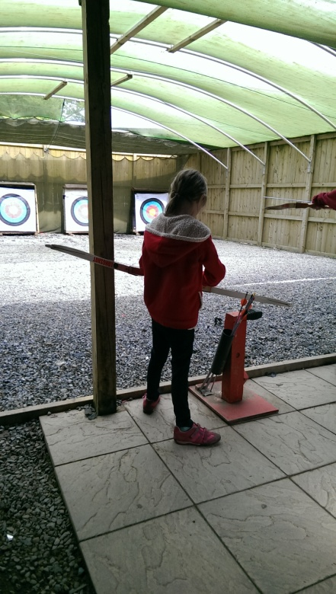
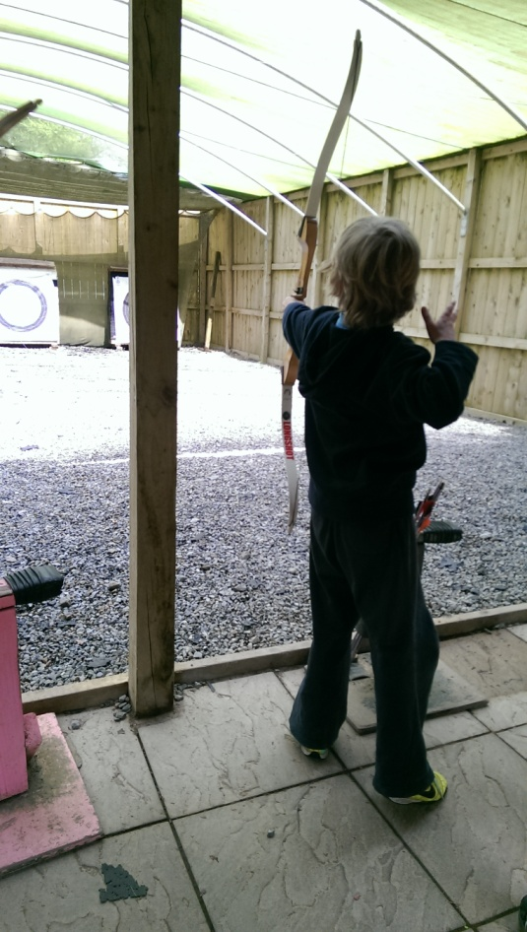
ARCHERY
Bullseye!!!
WE TOOK TURNS TO DO ARCHERYAND THE ARROWS AND THEY YOU HAD TO TRY AND HIT THE TARGETS

Slide 13
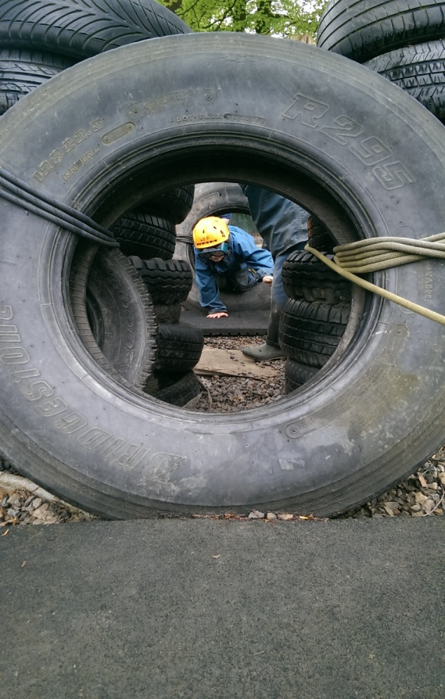
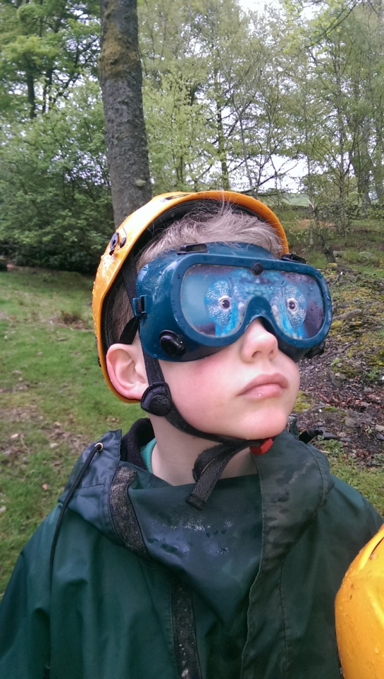
Night line
Where am I !!!!!!!
This is so cool!
It was awesome because the teachers squirted us with water guns but said the squirrels were weeing on us.GRR!!!
You can’t see a thing

Slide 14
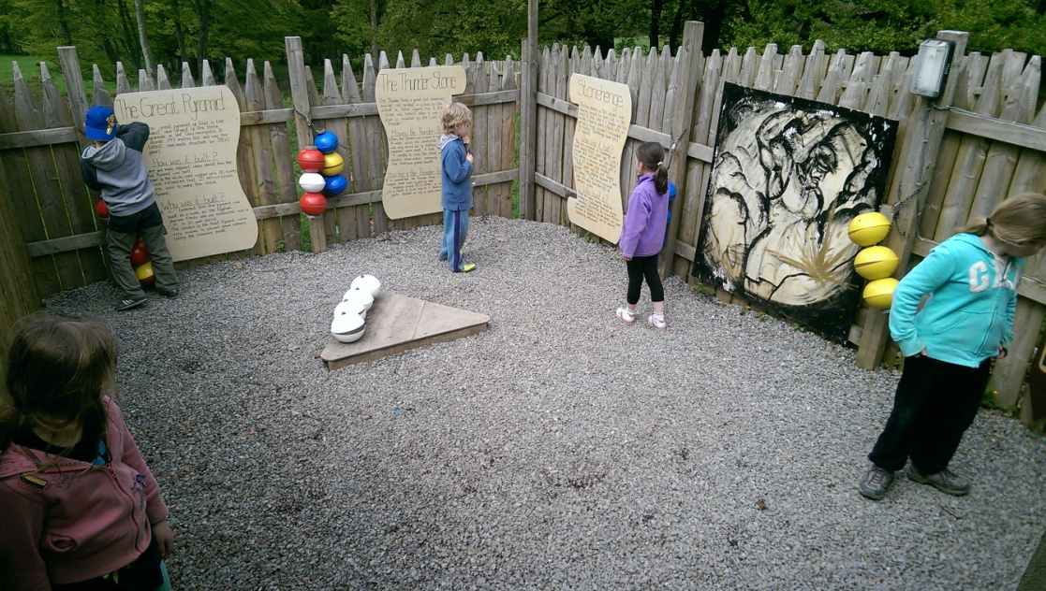
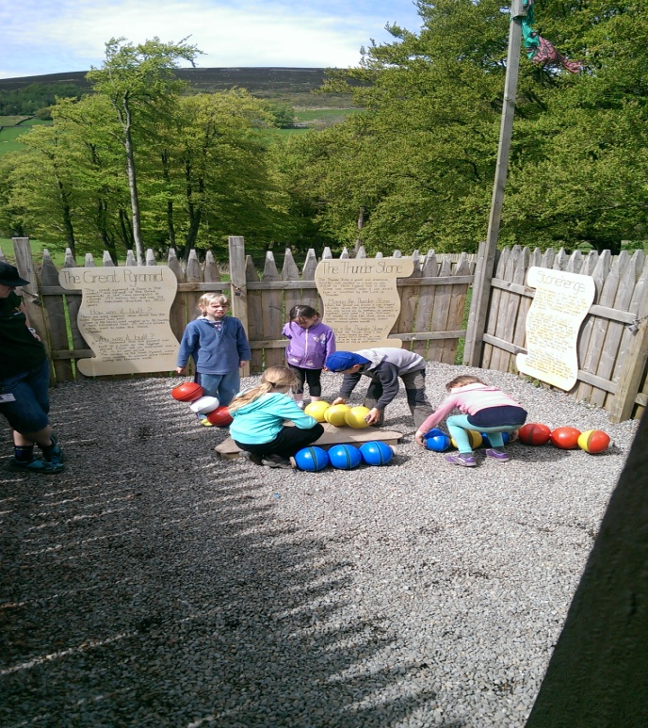
Dragon Quest
Hmm lets see here???
Its 1% scary you’ll see ;-)
What are these weird balls?
Bye I’m off

Slide 15
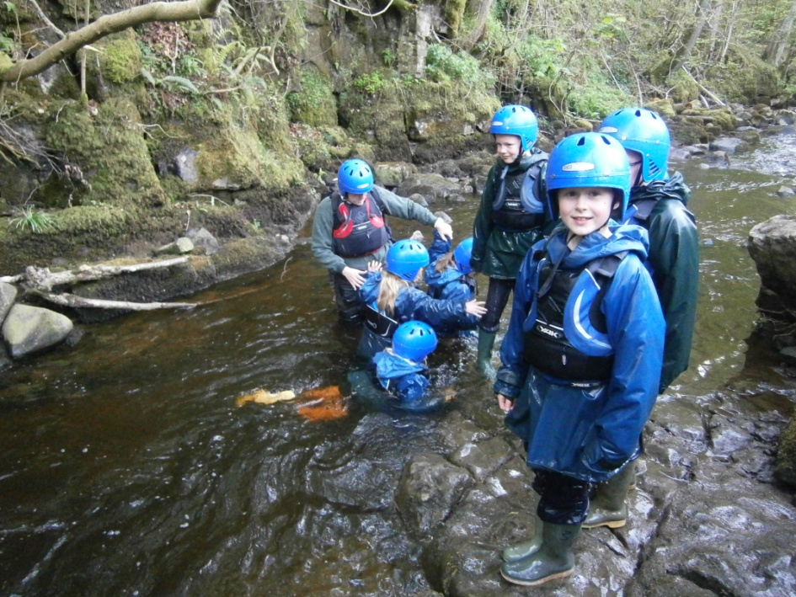
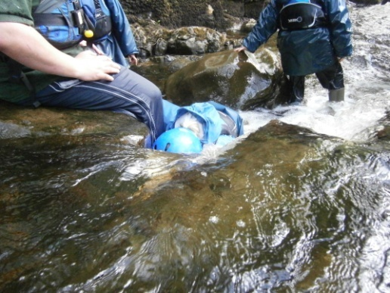
Stream Walk
Why is everyone on the floor!
It was soaking!
This is epic!
Sam fell over loads.[no change there]
I LOVED IT!
All heads under!
AWESOME!

Slide 16
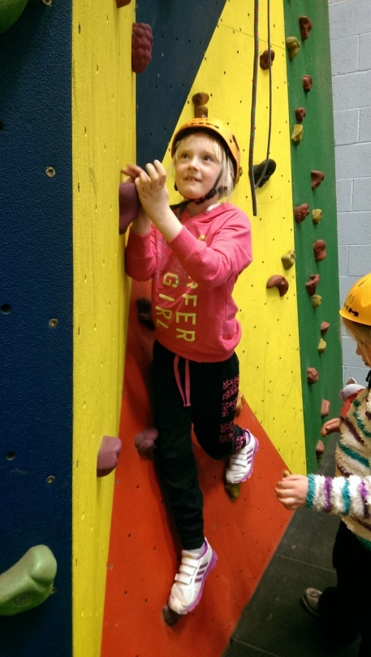
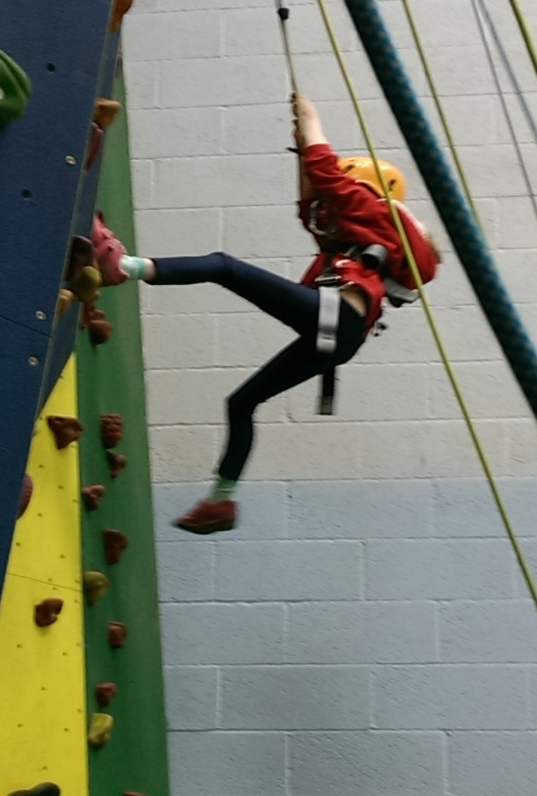
Climbing Wall
I am going this year!!
You only have to go as high as you want to go
If you get to the top you Can touch the dragon

Slide 17
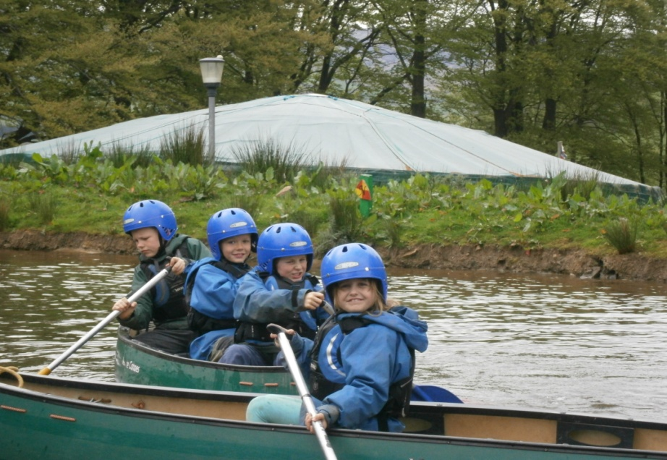
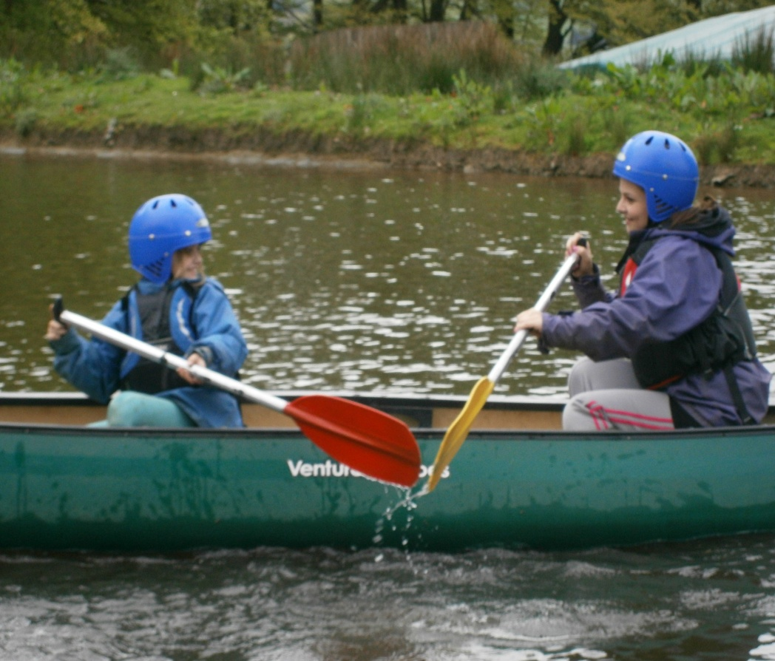
Canoeing
Hehe
he
Not Funny Leah!!
It was amazing and really fun
We played the ‘pirate game’ and the ‘try to get around the ducklings without touching them’ game.

Slide 18
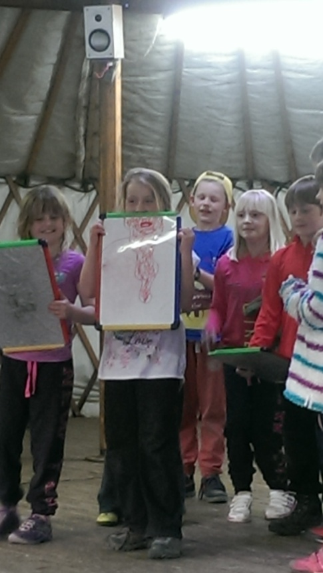
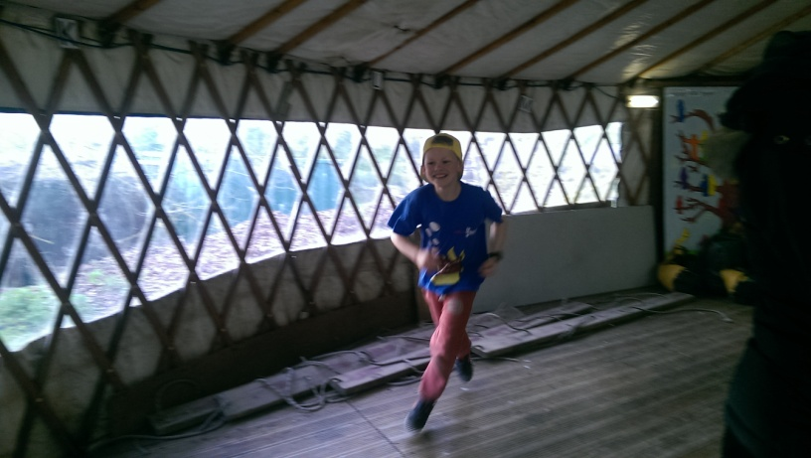
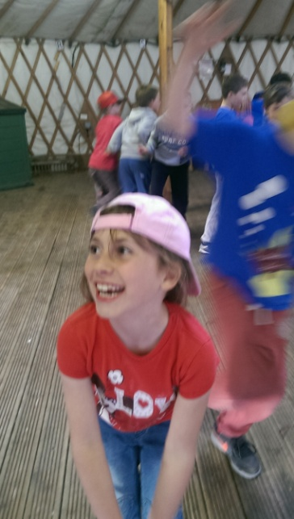
Team challenge
Amazing
You should come
Shocking
crazy
astonishing
Ha hahaha this is fun!!!!!!!!
We did lots of silly games and dancing.

Slide 19
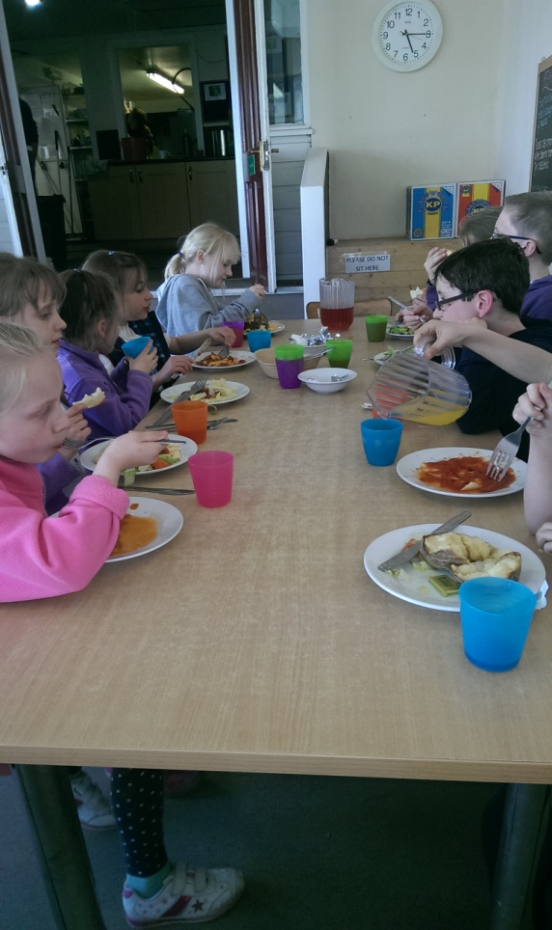
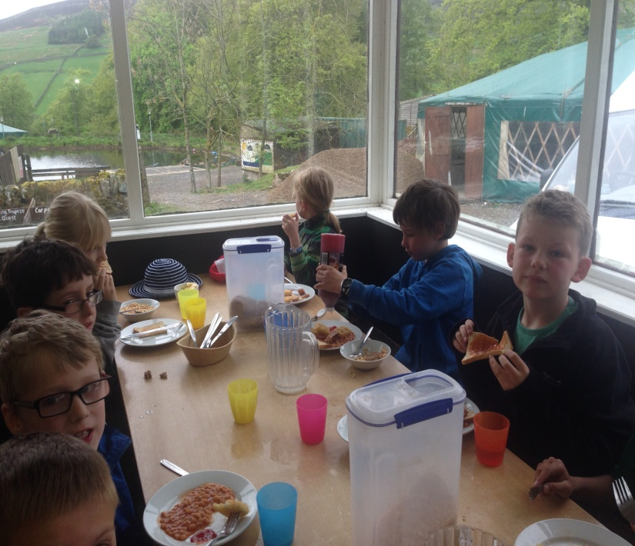
FOOD
You will love the food
pizza
Pasta
Hot Chocolate
and biscuits!
The Doughnut challenge
Yum!!
Ketchup!!!!!!
Ravioli
Spaghetti
Bolognese
Full English

Slide 20
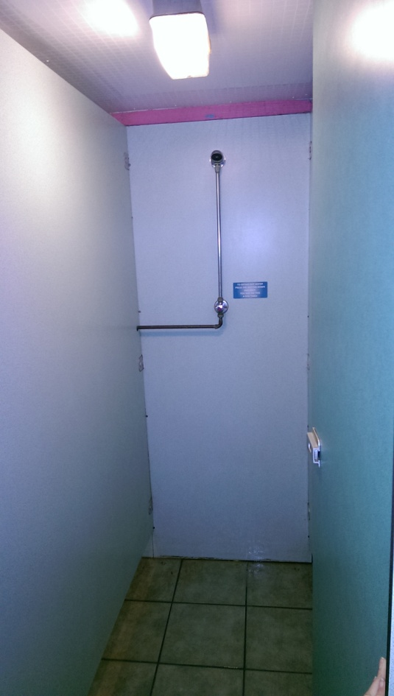
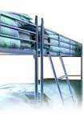
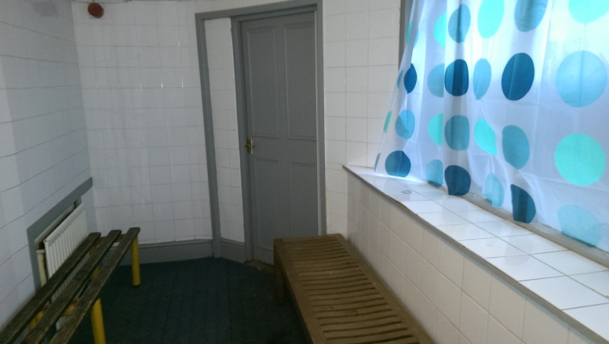
Showers + bedroom!!
You get to stay up till 10 o’clock
Ooh they are lovely and warm
You get to share room with all your friends.

Slide 21
Favourite Bits
“Me and Miss Richardson won the pirate game when we were doing canoeing, I stood up and almost fell in I was that excited!”
Ryan
“I kept falling over in the stream walk, Miss Fife had to keep helping me, it nearly made her fall over too!”
Jess B
On the giant swing I pulled Pooh and it didn’t work. I pulled it again and whooooosh off it went!”
Olivia
“I was in the cave and switched my light off but someone crept up in front of me and gave me a fright.”
Ben
“In caving I switched my torch off and hid from everyone.”
Daniel

Slide 22
Favourite Bits
“I loved the zip wire, you went really high and really fast!”
Nicola
“On the giant swing, Robert pulled in Pooh and I got a fright, it looked like we were going to hit the fence!”
James
“I liked the stream walk best....I got married to Ben!! It was a bit embarrassing but really funny!”
Leah
“I climbed the trapeze with Sting, it was really hard but I did it. I jumped for the bar with Sting under my arm and caught it with one hand!!”
Charlie
“On the giant swing I pulled on Pooh and Sam screamed, I couldn’t stop laughing at his face!”
Chloe
“In caving, my head torch kept turning off. It was really funny.”
Jess W

Slide 23
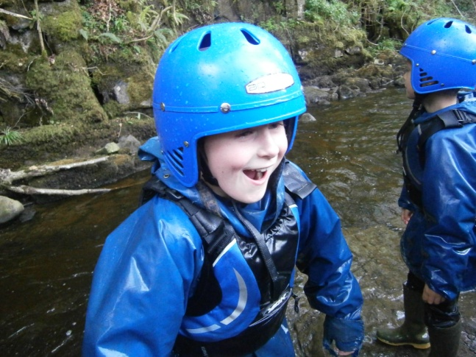
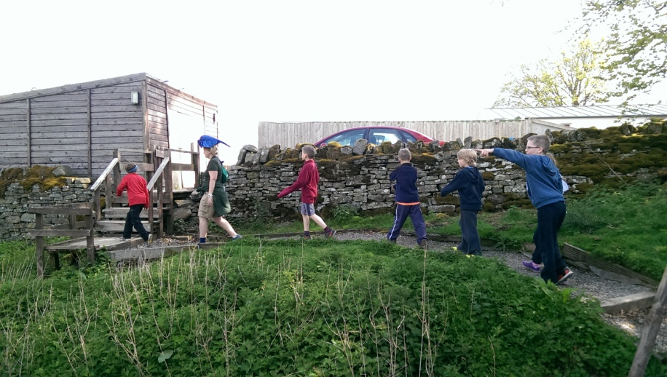
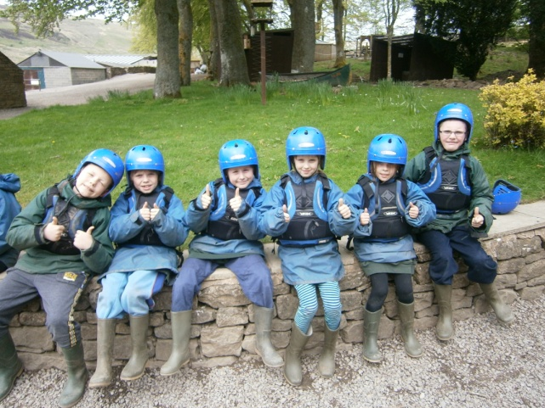
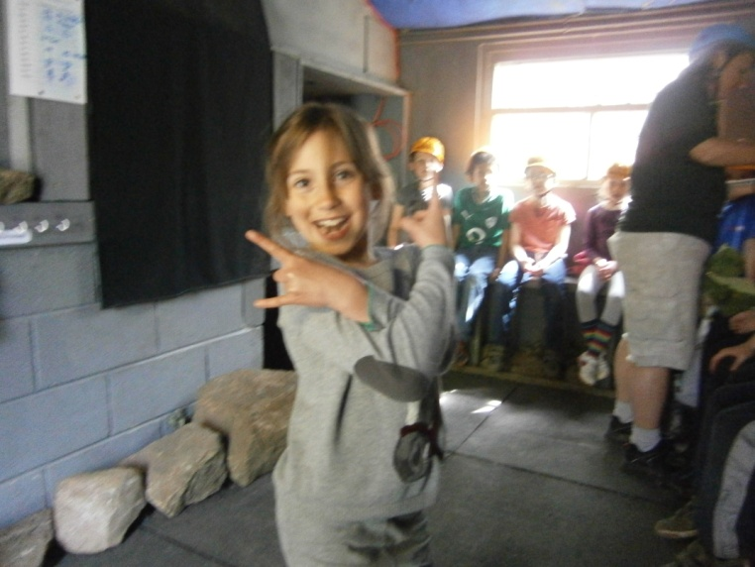
We can’t wait to go back!!

